Slide 1
Week 6 Case Expressions
Simple
Searched

Slide 2
Case Expressions
Simple and Searched:
Allows only equality comparisons.
Evaluates tests are evaluated in the order defined.
Returns the result corresponding to the first TRUE test.
If no match is made, case returns NULL unless ELSE is present.
https://www.essentialsql.com/sql-case-statement/
https://docs.microsoft.com/en-us/sql/t-sql/language-elements/case-transact-sql?view=sql-server-2017

Slide 3
Case Expressions Syntax
Transformation
Standardization
SELECT JobTitle,
CASE Gender
WHEN 'M' THEN 'Male'
WHEN 'F' THEN 'Female'
ELSE 'Unknown Value'
END
FROM HumanResources.Employee
SELECT JobTitle,
CASE Gender
WHEN 'M' THEN 'Male'
WHEN '0' THEN 'Male'
WHEN 'F' THEN 'Female'
WHEN '1' THEN 'Female'
ELSE 'Unknown Value'
END
FROM HumanResources.Employee

Slide 4
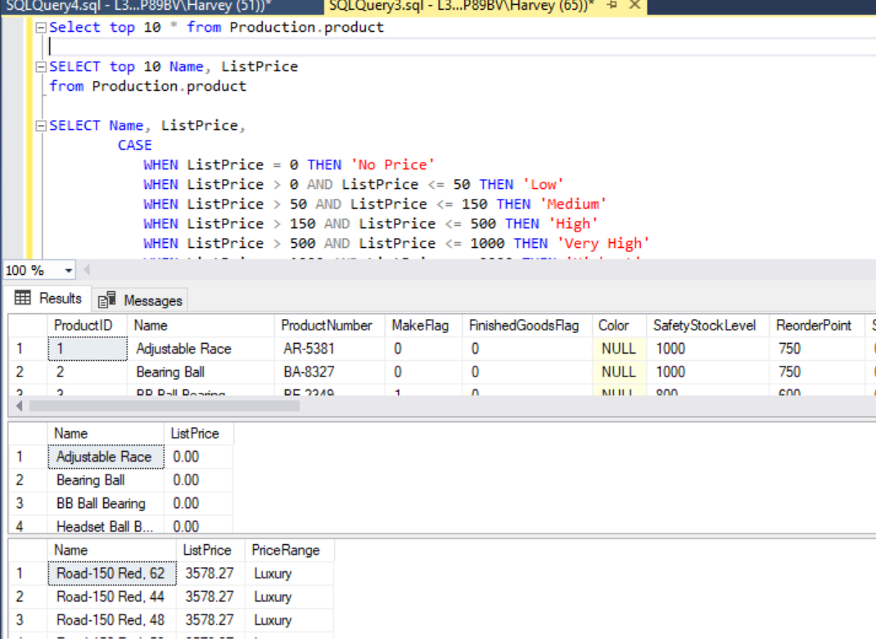
Case Expressions: Example Code
Select top 10 * from Production.product /*what columns in this table*/
SELECT top 10 Name, ListPrice /*display name and list price only*/
from Production.product
SELECT Name, ListPrice, /*case expressions by range*/
CASE
WHEN ListPrice = 0 THEN 'No Price'
WHEN ListPrice > 0 AND ListPrice <= 50 THEN 'Low'
WHEN ListPrice > 50 AND ListPrice <= 150 THEN 'Medium'
WHEN ListPrice > 150 AND ListPrice <= 500 THEN 'High'
WHEN ListPrice > 500 AND ListPrice <= 1000 THEN 'Very High'
WHEN ListPrice > 1000 AND ListPrice <= 2000 THEN 'Highest'
WHEN ListPrice > 2000 THEN 'Luxury'
ELSE 'UNLISTED'
END as PriceRange
FROM Production.Product
order by ListPrice DESC

Slide 5
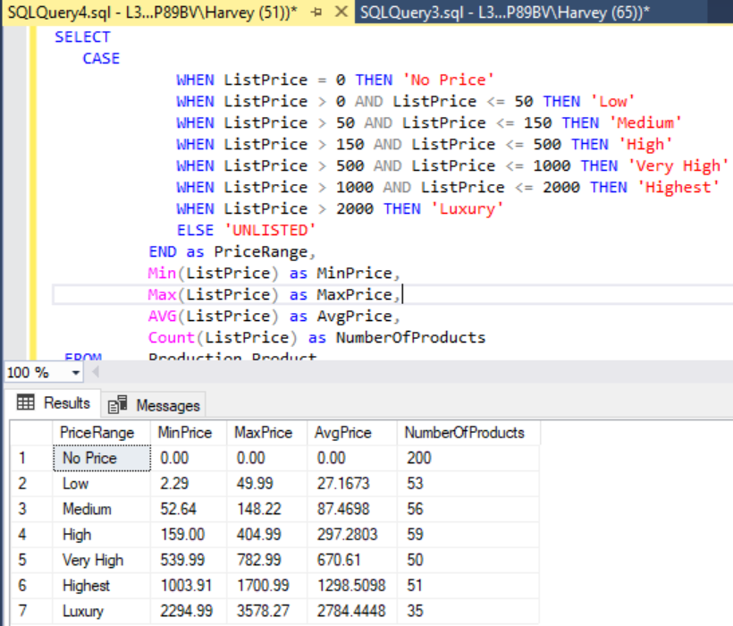
Case Expressions Example Code
SELECT
CASE
WHEN ListPrice = 0 THEN 'No Price'
WHEN ListPrice > 0 AND ListPrice <= 50 THEN 'Low'
WHEN ListPrice > 50 AND ListPrice <= 150 THEN 'Medium'
WHEN ListPrice > 150 AND ListPrice <= 500 THEN 'High'
WHEN ListPrice > 500 AND ListPrice <= 1000 THEN 'Very High'
WHEN ListPrice > 1000 AND ListPrice <= 2000 THEN 'Highest'
WHEN ListPrice > 2000 THEN 'Luxury'
ELSE 'UNLISTED'
END as PriceRange,
Min(ListPrice) as MinPrice,
Max(ListPrice) as MaxPrice,
AVG(ListPrice) as AvgPrice,
Count(ListPrice) as NumberOfProducts
FROM Production.Product
GROUP BY CASE
WHEN ListPrice = 0 THEN 'No Price'
WHEN ListPrice > 0 AND ListPrice <= 50 THEN 'Low'
WHEN ListPrice > 50 AND ListPrice <= 150 THEN 'Medium'
WHEN ListPrice > 150 AND ListPrice <= 500 THEN 'High'
WHEN ListPrice > 500 AND ListPrice <= 1000 THEN 'Very High'
WHEN ListPrice > 1000 AND ListPrice <= 2000 THEN 'Highest'
WHEN ListPrice > 2000 THEN 'Luxury'
ELSE 'UNLISTED'
END
ORDER BY MinPrice

Slide 6
Case Expression Exercise
Create a case expression to evaluate a range of values and produce a summary table.
Case expression should support a user story for producing a report of a query for a question the user wants the answer to.

